Slide 1

1000 youtube channels that are most subscribed (1970-2021)
COLUMNS :
Rank ,Youtube channel, Subscribers, Video Views,Video Count ,Category

Slide 2
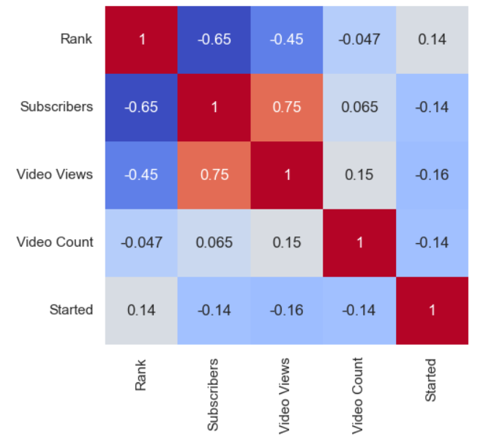
There is co-relation between all the variables.
IMPORTANT CODE SNIPPETS:
corr=df.corr()
sns.heatmap(corr, annot=True, cmap='coolwarm’)
Packages used :
Seaborn for visualization
Pandas for using dataframe
OBSERVATIONS:
Subscribers and rank have highest negative relation that means inversely propotional(least co-relation).
Video views and subscribers have highest positive relation , that means directly propotional(greatest co-relation).

Slide 3
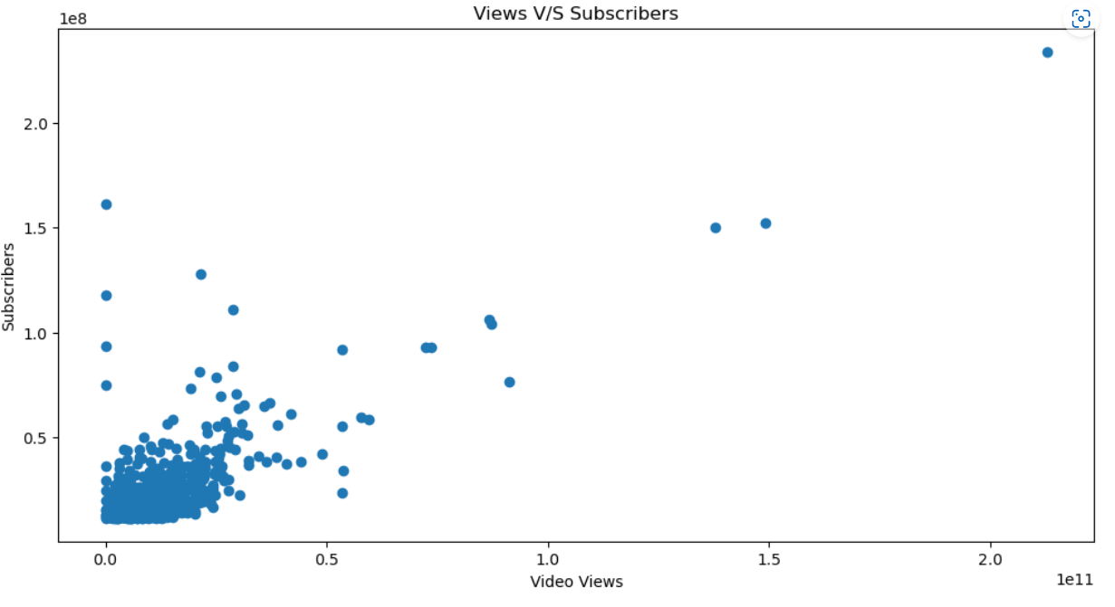
YouTube channels with a higher number of video views tend to have a higher number of subscribers
Important code snippets
plt.scatter(x= df['Video Views'] , y = df['Subscribers’] )
plt.xlabel("Video Views")
plt.ylabel("Subscribers")
plt.title("Views V/S Subscribers")
Observations:
There are some cases where the video views are 0 but the number of subscribers are high.

Slide 4
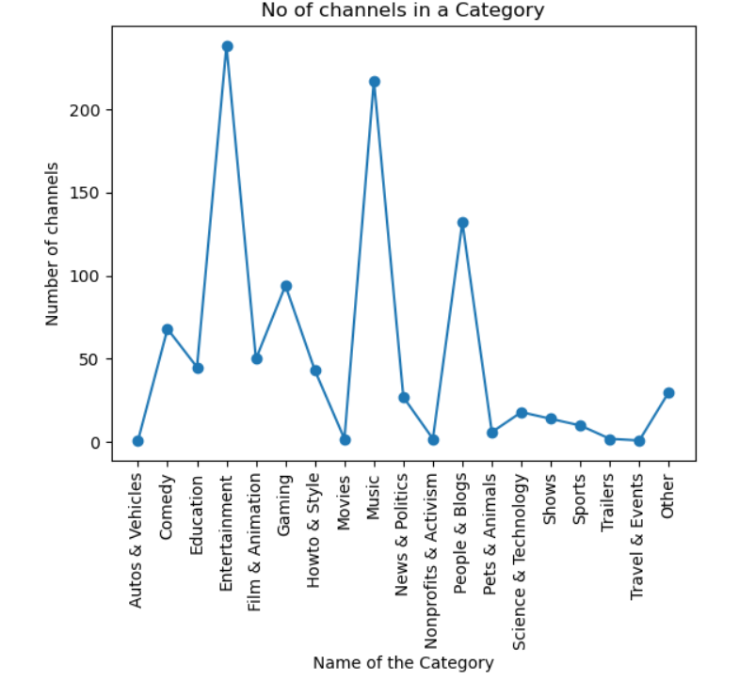
Which category has more number of channels?
Important Code Snippets:
df_temp=df[['Category','Youtube Channel’]]
category = df_temp.groupby('Category', as_index=False)['Youtube Channel'].count()
Replace function
ax.plot(category['Category'], category['Youtube Channel'],marker='o’)
Observations:
More number of channels in youtube are from Entertainement ,Music and People's and Blogs.

Slide 5
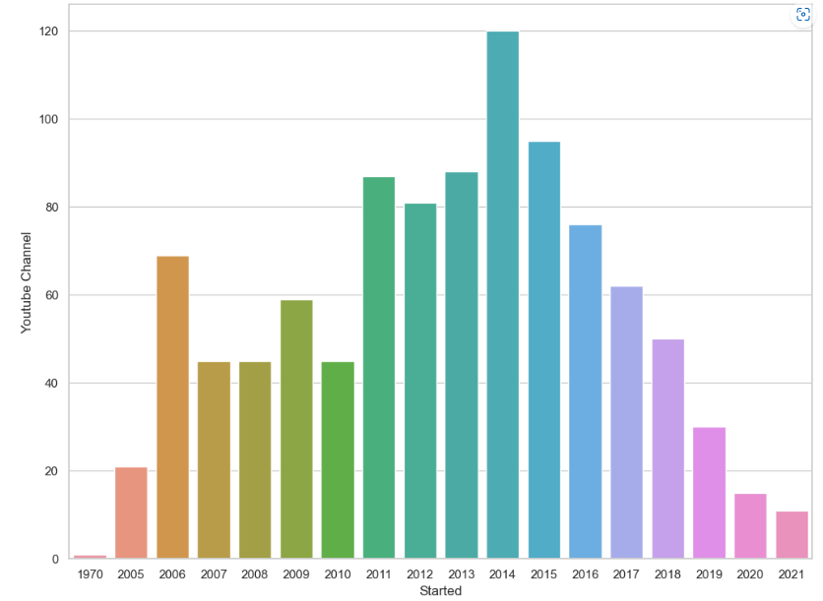
There is growth in number of channels from 1970 to 2021
Important Code Snippets
newdf= df[['Youtube Channel', 'Started’]]
newdf = newdf.groupby("Started").count()
ax = sns.barplot(x = newdf.index , y = 'Youtube Channel' , data= newdf)
Observations:
We assumed that there would be a growth in the number of channels from 1970 to 2021.
There was no constant growth , but there was growth till 2014 , and then it had a constant downfall.

Slide 6
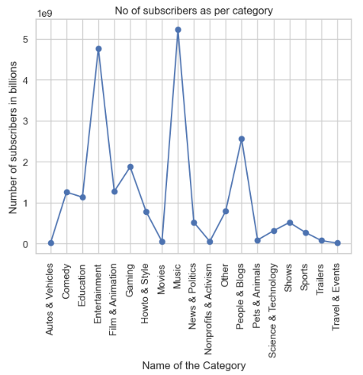
Which category has more subscribers irrespective of the channel
Important Code Snippets
df_temp1=df[['Category','Subscribers’]]
df_temp1 = df_temp1.groupby("Category").sum()
ax.plot(df_temp1.index, df_temp1['Subscribers'],marker='o’)
Observations:
Music on total channels has more than 5 billion subscribers.

Slide 7
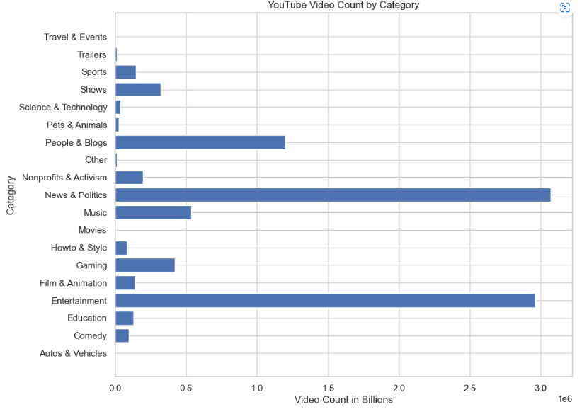
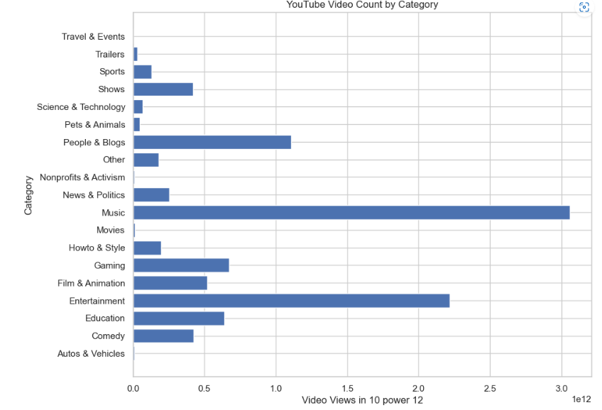
Which category has more number of video count and video Views
Important Code Snippets
df_temp2=df[['Category','Video Count’]] df_temp3=df[['Category','Video Views’]]
df_temp2 = df_temp2.groupby("Category").sum() df_temp3 = df_temp3.groupby("Category").sum()
ax.barh(df_temp2.index, df_temp2['Video Count'], align='center’) ax.barh(df_temp3.index, df_temp3['Video Views'], align='center’)
Observations: "News and Politics" Music

Slide 8
Conclusion
Music and entertainment categories are the most popular on YouTube in terms of subscribers and views.
The News and Politics category has the most number of videos
Growth of the number of channels has not been consistent over time
Reference :
https://www.kaggle.com/datasets/themrityunjaypathak/most-subscribed-1000-youtube-channels

